Slide 1

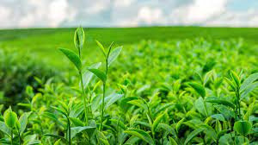
INDIAN AGRICULTURAL ANALYSIS
MENTORNESS INTERNSHIP PROGRAM

Slide 2

PROBLEM STATEMENT
This internship project aims to conduct a comprehensive analysis of Indian agriculture, focusing on district-wise and year-wise data.
The dataset provides detailed information on various crops, their areas, production, and yields across different districts and years.
The goal is to leverage Power BI to create interactive visualizations that uncover trends, patterns, and disparities in agricultural practices, enabling stakeholders to make informed decisions for sustainable farming and resource allocation.

Slide 3

Objectives
Regional Disparities:
- Identify disparities and variations in agricultural practices and outcomes across different districts and
states.
Crop-specific Analysis:
- Analyze the trends in the cultivation of major crops, including rice, wheat, and pulses, focusing on
changes in area, production, and yield.
Sustainable Farming Insights:
- Derive insights that can contribute to promoting sustainable farming practices and optimizing resource
allocation.
Back to Agenda

Slide 4
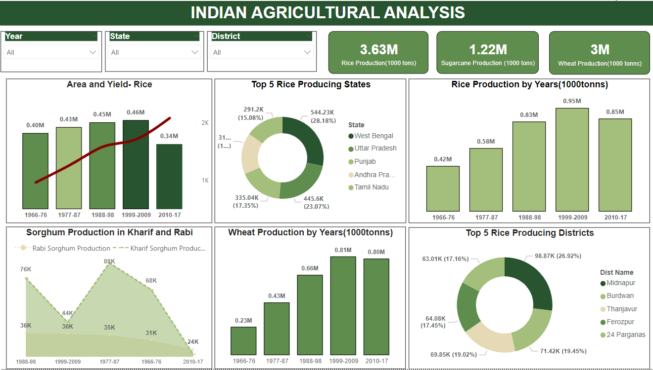

Slide 5
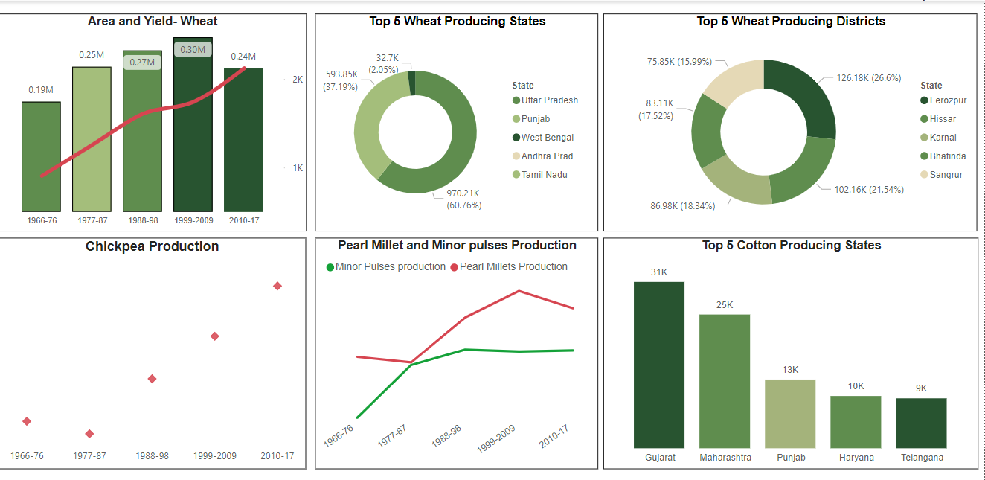

Slide 6
INSIGHTS
Rice production has peaked at 3.63 million thousand tons, marking it as the highest among all crops.
Wheat production stands at 3 million thousand tons, making it the second-highest crop in terms of production.
Sugarcane production stands at 1.22 million thousand tons.
The yield of rice production has shown a consistent increase over time, indicating a positive trend in productivity. This suggests ongoing improvements in rice cultivation practices and potentially enhanced agricultural efficiency.
West Bengal is the foremost producer of rice, followed by Uttar Pradesh, Punjab, Andhra Pradesh, and Tamil Nadu, respectively.
The highest rice production is observed during the decade spanning from 1999 to 2009.
Midnapur, Burdwan, and Thunjavur emerge as the top districts for rice production, indicating their significant contribution to overall rice output.
Sorghum production during the Kharif season surpasses its production during the Rabi season. This highlights the seasonal variability in sorghum cultivation.
Wheat production demonstrates a consistent increase in yield over the years
Chickpea production is steadily increasing each year, indicating a consistent rise in the quantity of chickpeas harvested annually.
Cotton production is predominant in Gujarat, Maharashtra, and Punjab.

Slide 7
RECOMMENDATIONS
Implement water-efficient irrigation techniques, especially in rice cultivation, to optimize water usage.
Offer extension services and training programs to optimize sorghum cultivation practices during both Kharif and Rabi seasons.
Promote improved seed varieties and integrated pest management techniques.
Offer access to improved seeds, fertilizers, and training on best agronomic practices.
Provide access to high-quality seeds, technical knowledge, and financial support to promote chickpea cultivation.
Advocate for policies incentivizing sustainable agricultural practices and crop diversification,Encourage governments to create rules that reward farmers for using eco-friendly ways of farming and growing different kinds of crops.
Engage with policymakers to develop evidence-based policies addressing agriculture sector challenges.
Invest in research and development initiatives aimed at improving sugarcane and cotton cultivation techniques, especially in regions like Gujarat, Maharashtra, and Punjab where they are predominant, to maximize their yield potential and profitability.

Slide 8


